Slide 1
MedLink
Project Presentation
Developed as part of the Infosys Springboard Internship 6.0
Presented by:
Shalini
Aman Nagar
Sanjana
Shaikun Rani
Sruthi
Nilvana
Mentor:
Vinay Prashant sir

Slide 2
MedLink
Online Prescription and Medication Tracker
MedLink is a role-based healthcare management application where patients can track medications, reminders, vitals, and profile data, and doctors can manage patients, monitor summaries, and create prescriptions. The system is built with React Native on the frontend, Spring Boot on the backend, and MongoDB as the database.
Problem Statement
Patients struggle with medication management due to lack of reminders, poor tracking, and fragmented medical data. There is also limited doctor-patient coordination and no instant support for drug-related queries, leading to reduced adherence and potential health risks.

Slide 3
Project Overview
The Vision
Core Value
MedLink is a role-based healthcare management application designed to streamline patient care and medication adherence whilst enabling efficient doctor-patient coordination.
Patients manage medications, reminders, vitals, and profiles. Doctors manage patients, monitor summaries, and create prescriptions—all within one secure, integrated system.
Patient Portal
Doctor Dashboard
Secure Backend
Medication tracking, adherence monitoring, vitals logging, and profile management
Patient management, prescription creation, and health summary monitoring
Role-based access control with JWT authentication and MongoDB persistence

Slide 4
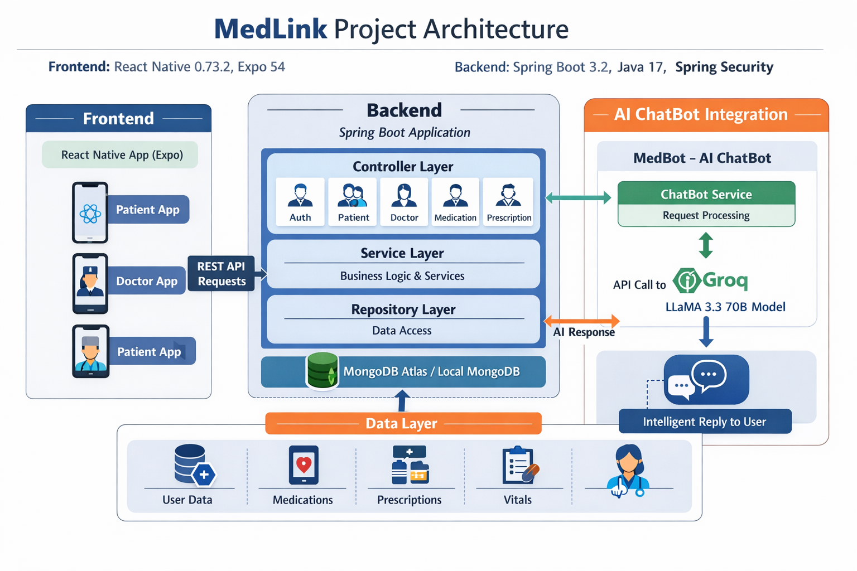

Slide 5
Medication Scheduling Flow
📝Form Entry Patient enters medication details including name, dosage, frequency, and timing.
✔️Frontend Validation Input fields are validated to ensure accuracy before submission.
🔗API Request Data is sent to backend via POST /api/medications/schedule.
🗄️Data Storage Medication schedule is securely stored in MongoDB.
⚙️Log Generation System automatically generates intake logs based on schedule.
📊Status Tracking Each log is tracked as Pending, Taken, Missed, or Skipped.
🔄Data Refresh Dashboard updates in real-time to reflect latest medication data.

Slide 6
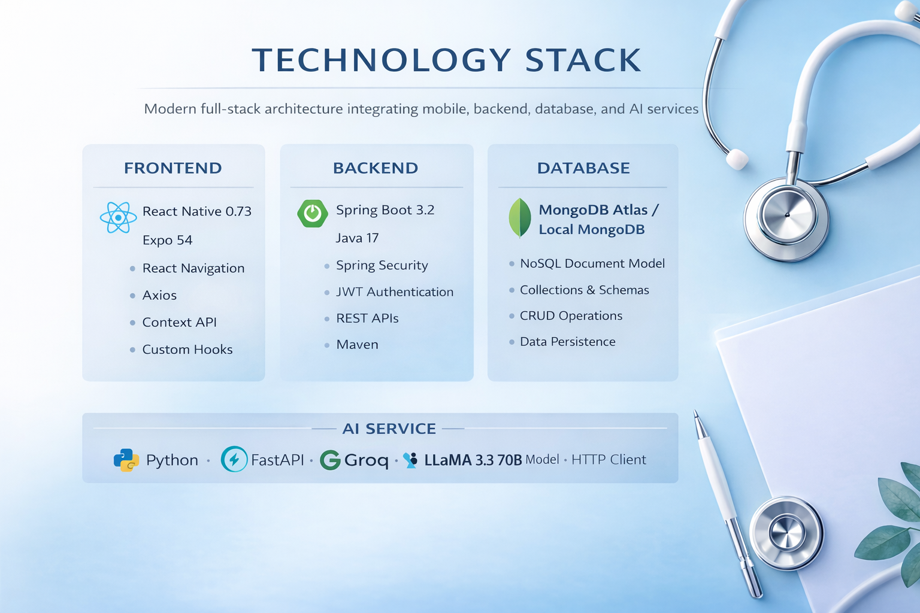

Slide 7
Database Collections
MongoDB document-based schema stores all user data, medical profiles, medication schedules, and health metrics.
Users
Patients
Doctors
Authentication identity with role, email, password, and phone number
Medical profiles including age, blood group, allergies, emergency contacts, and assigned doctor
Professional details such as specialization, hospital, experience, availability, and patient lists
Medication Schedules
Intake Logs
Prescriptions
Medication names, dosage, frequency, times, and start/end dates
Scheduled date/time with status tracking: taken, missed, skipped, or pending
Doctor-patient prescription details with medication lists and instructions
Vital Signs
Blood pressure, heart rate, glucose, temperature, stress, oxygen, and weight measurements

Slide 8
Authentication & Security
JWT-Based Stateless Authentication
Security Features
Registration and login endpoints handle user credentials with BCrypt password encryption. Successful authentication generates JWT tokens for secure API access.
BCrypt password encryption
Bearer token authorization
Role-based route protection
Stateless session management
Backend APIs are protected based on user roles—doctor endpoints restricted to doctors, patient endpoints to patients, with selective cross-access routes.
01
02
03
Registration
BCrypt Hashing
JWT Generation
User creates account with email and password
Password encrypted before storage
Token created after successful login
04
05
API Access
Role Validation
Bearer token sent with each request
Spring Security checks permissions

Slide 9




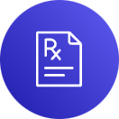

Doctor Module
The doctor side focuses on patient management and prescription workflow through comprehensive dashboards and administrative tools.
Dashboard
Patient List
Summary information and recent patient activity monitoring
View all assigned patients with search and filtering capabilities
Patient Search
Add Patient
Quickly find patients by name, condition, or medication
Link new patients to doctor's practice with profile details
Create Prescription
Profile
Prescribe multiple medications with dosage, frequency, instructions, and duration
Professional information including specialization, hospital, qualifications, and consultation timings

Slide 10






Patient Module
The patient side focuses on daily medication adherence and personal health monitoring through intuitive dashboards and tracking screens.
Dashboard
Add Medication
Medication summary, today's medications, adherence insights, and quick navigation
Save medication schedules with dosage, frequency, time, and date range
Schedule View
Reminders
Day-wise medication schedule with status marking capability
Pending medication notifications and time-based alerts
Vitals
Profile
Log and display health metrics with trend analysis
Personal and health-related information with edit functionality

Slide 11
MedBot – AI-Based Drug Interaction Feature
MedBot is an AI-powered medical assistant that helps users safely manage medication usage by analyzing drug interactions in real time
Users can ask queries like “Can I take paracetamol with ibuprofen?” and receive instant, structured medical guidance
Core Capabilities:
Identifies drug compatibility and interactions
Provides dosage and timing recommendations
Highlights possible side effects and risks
Suggests safe alternatives and contraindications
Risk Awareness:
Detects potential issues such as liver damage, stomach ulcers, and kidney problems
Advises caution for long-term usage and high dosages
User-Centric Design:
Simple chat-based interface for easy interaction
Quick navigation with features like Drug Interaction, Side Effects, Dosage Guide
Delivers fast, accurate, and easy-to-understand responses
Impact:
Enhances patient safety and awareness
Reduces chances of harmful drug combinations
Acts as a first-level healthcare support system
Disclaimer: This system provides informational guidance only and does not replace professional medical consultation

Slide 12
Key Features & Technical Enhancements
Adherence Monitoring
Implements a robust logic layer that aggregates intake logs. It computes metrics for taken, missed, and pending doses, calculating adherence percentage via a weighted algorithm stored in the user profile state.
Vitals Module
Uses a schema-validated model to ingest health metrics. The backend processes these against clinical thresholds to dynamically assign status classifications (NORMAL, ELEVATED, HIGH) using event-driven status updates.
Theme Persistence
Leverages Async Storage to synchronize user preference state across application sessions, coupled with a CSS-in-JS provider pattern that ensures theme-consistent rendering across web and mobile viewports.
Core API Architecture
• The system follows a RESTful API architecture to enable communication between the frontend and backend components.
• The Controller layer receives requests from the client application and forwards them to the appropriate services.
• The Service layer processes the business logic such as medication scheduling, prescription storage, and reminder generation.
• The Repository layer interacts with the database to store and retrieve patient, medication, and prescription data.
• The APIs ensure secure and efficient data exchange between users and the system.
• The architecture improves scalability, maintainability, and modular development of the application.
Future Technical Roadmap
Push Notifications Integration with Firebase Cloud Messaging (FCM) to send medication reminders and alerts.
Live Updates Web Sockets enable real-time communication for instant dashboard updates.
Cloud Storage Secure storage of prescriptions and reports using S3-compatible cloud services.
Calendar Integration Appointment scheduling synchronized with external calendars using iCal standards.

Slide 13
Conclusion: Empowering Healthcare with MedLink
MedLink represents a significant step forward in digital healthcare, delivering a comprehensive platform designed to improve patient outcomes and streamline medical practice.
Enhanced Patient Adherence
Efficient Doctor Workflow
Robust Security & Data Privacy
Intuitive medication scheduling and timely reminders drive consistent intake, directly impacting patient health.
From patient management to prescription generation, doctors benefit from a centralised, easy-to-use system.
JWT authentication and role-based access ensure sensitive patient data remains secure and protected.
Scalable & Modern Architecture
Built with Spring Boot, MongoDB, and React Native, MedLink is future-proof and ready for continuous enhancement.

Slide 14
Thank You for Your Time
We appreciate your attention and engagement during this presentation of MedLink.
We believe MedLink is poised to make a significant impact on patient care and healthcare efficiency, empowering both patients and medical professionals.
Questions & Discussion
We are now open for any questions you may have, and eager to discuss how MedLink can best serve your specific needs and integrate into existing workflows.
Get in Touch
Feedback Welcome
For further inquiries or a detailed demonstration tailored to your organisation, please contact our team to schedule a follow-up.
Your valuable insights are crucial as we continue to refine and enhance MedLink to meet the evolving demands of modern healthcare.

